Slide 1


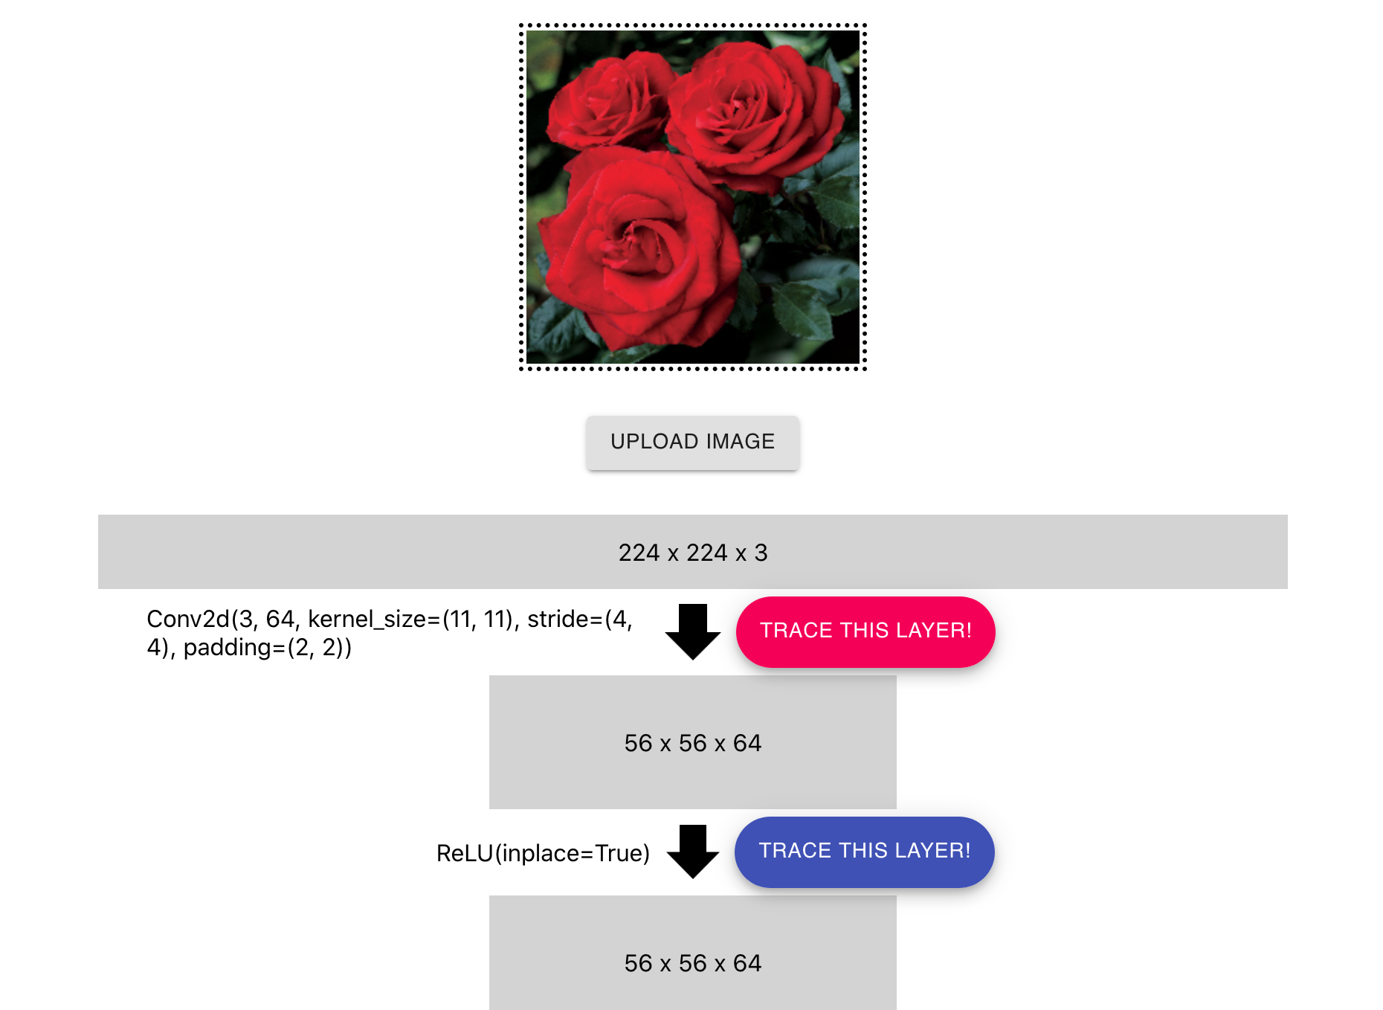
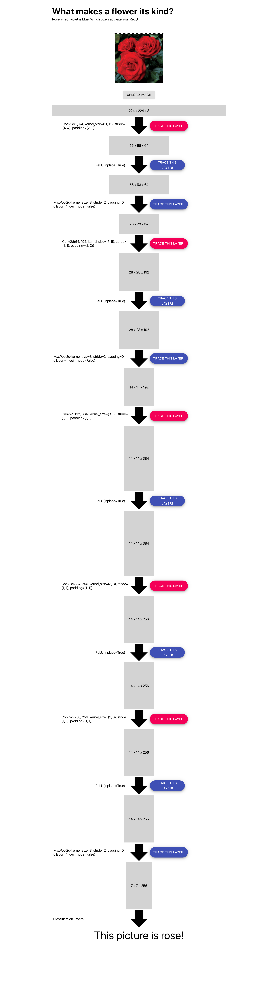
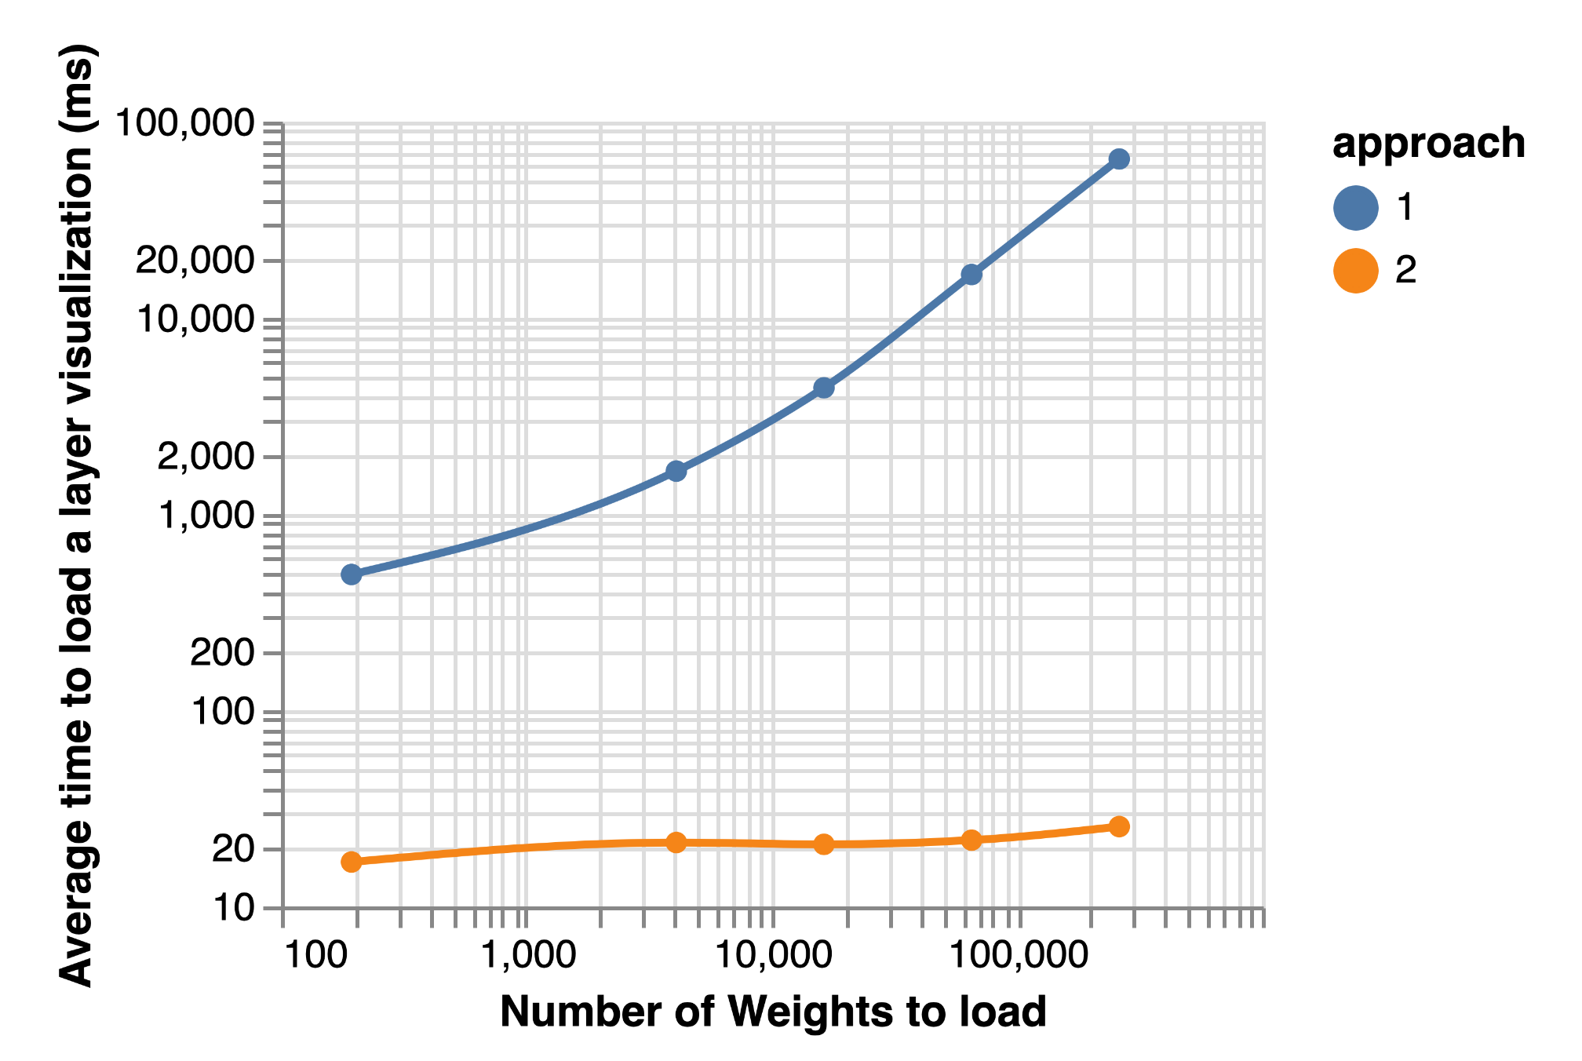
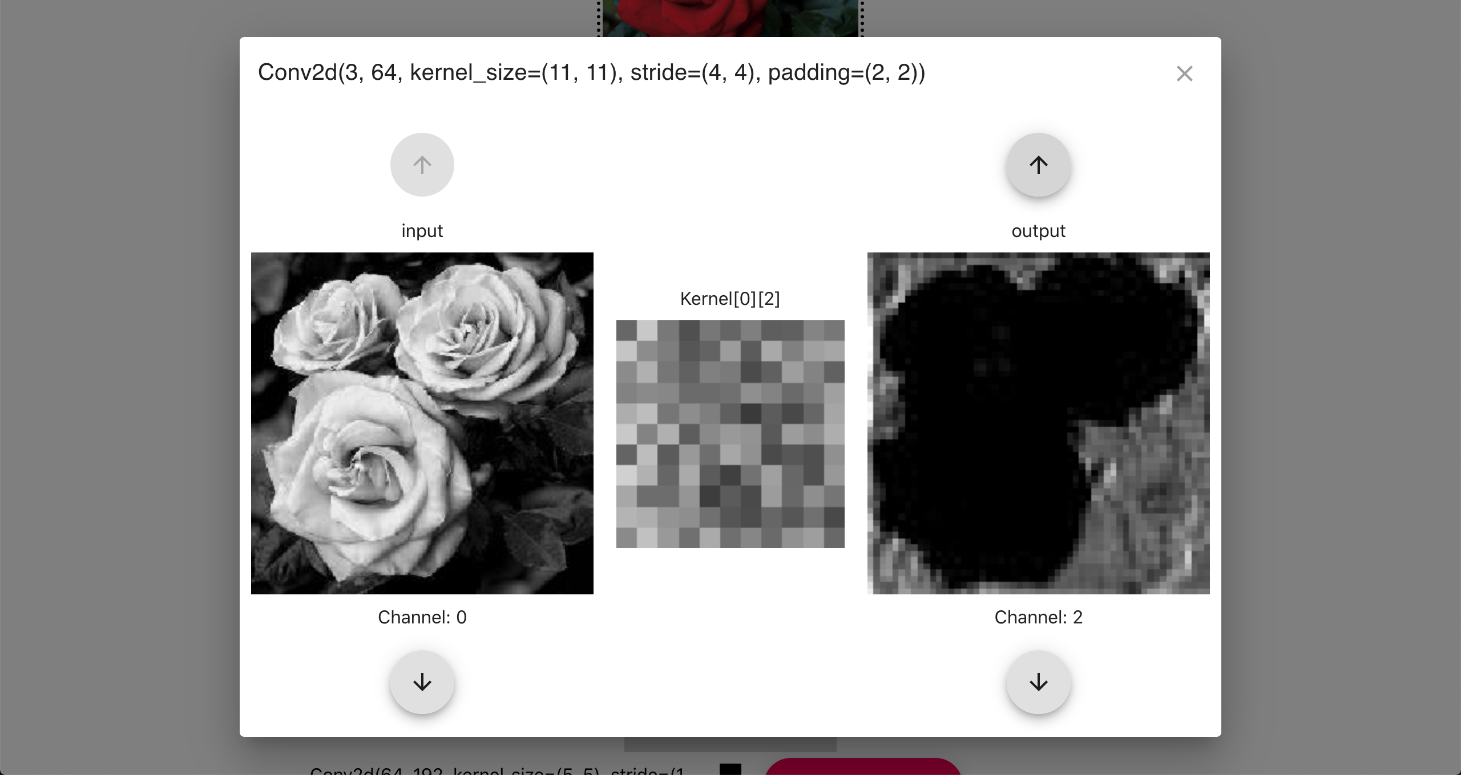
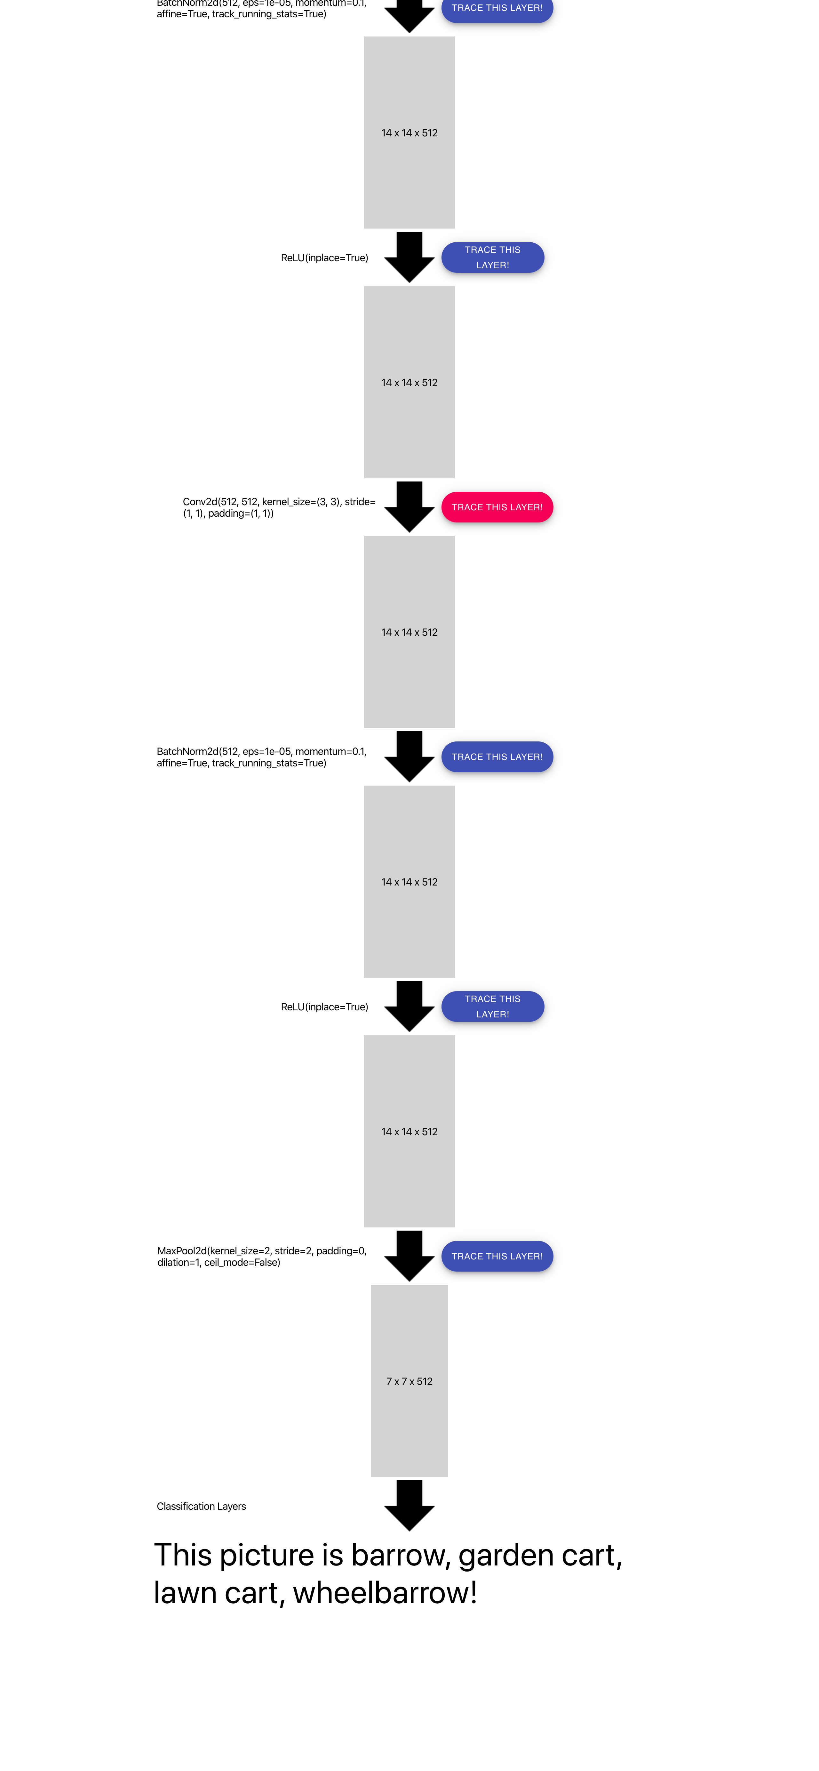
What makes a flower its kind.
Interactive visualization tool for visualizing layout of Convolutional Neural Network
Chanwut Kittivorawong, Podshara Chanrungmaneekul
Usability
Introduction
Table comparing the performance of loading visualization and loading single weight of both approaches.
Learning to understand the convolutional neural network is difficult for beginners who do not have much experience with machine learning and computer vision and it is hard what is going on between each layer that makes the network comes up with the output. For this reason, we created a tool that can visualize a sequence of convolutional layers in a neural network written using PyTorch, specifically their inputs, outputs, and weights. This tool helps beginners to start learning neural network by understanding how a neural network “think” of the input image through the visualization of each layer, as well as a useful debugger tool to look inside a network when something goes wrong.
Number of weights | Time to load a visualization for one layer (ms) |  | Time to load a single weight (ms)
 | First approach | Second approach | First approach | Second approach
3 x 64 | 492 | 464 | 0 to 2 | 16.84
64 x 64 | 1656 | 512 | 0 to 2 | 21.18
128 x 128 | 4400 | 440 | 0 to 2 | 20.71
256 x 256 | 16624 | 494 | 0 to 2 | 21.77
512 x 512 | 64551 | 706 | 0 to 2 | 25.52
Click ‘Upload Image’ to upload an image to classify
Modularity
One of the main reason we build this tool is to have a generalizable visualizer that works across sequential CNNs. We have created a VisualizableSequential module that can be used to replace the original network’s own Sequential of convolutional layers. Then, it extract the input, output, and weights to visualize them when plugging the network into this application.
Performance
We have tried two approaches to calculate and display weights of convolutional layers, to give the best performance in the visualization. For the first approach, every time users click to visualize each layer, the application loads all the weights in the layer and convert them into images. For the second approach, the application loads each weight lazily; that is, it only loads and convert weight into an image only when requested. Here is the result from performance testing
After the image is classified, the application visualize the network
layout in the convolutional sequential layers. Click “Track this Layer”
To visualize the input, output, and weight of the layer
Switch out the underlying neural network from AlexNet to VGG by replacing VGG’s own sequential convolutional part with our own VisualizableSequential module with the same layout.
We choose to go with the second approach. Even though the loading time for a single weight for the second approach is more than that of the first approach the difference is almost unnoticeable in real-world usage (see table above), but it reduces a big portion of initial loading time when loading the visualization for each layer.
After the layer visualization popped up, the user can choose
which pair of the input-output channels to be displayed.
The visualization also shows the weight that convolve
the selected input channel to the selected output channel.

